Slide 1
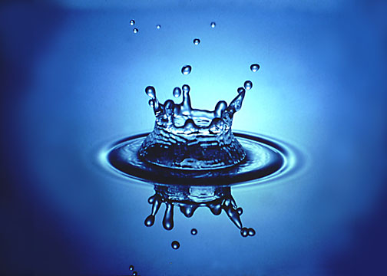
Fluid Mechanics II
Flow in open channels
Dr. Afsaneh Mojra
Dept of Mechanical Engineering

Slide 2
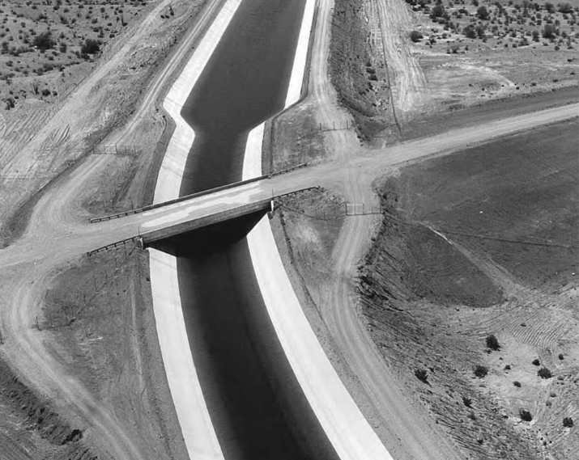
Flow in open channels
Flow in Open Channels Dr. Afsaneh Mojra

Slide 3
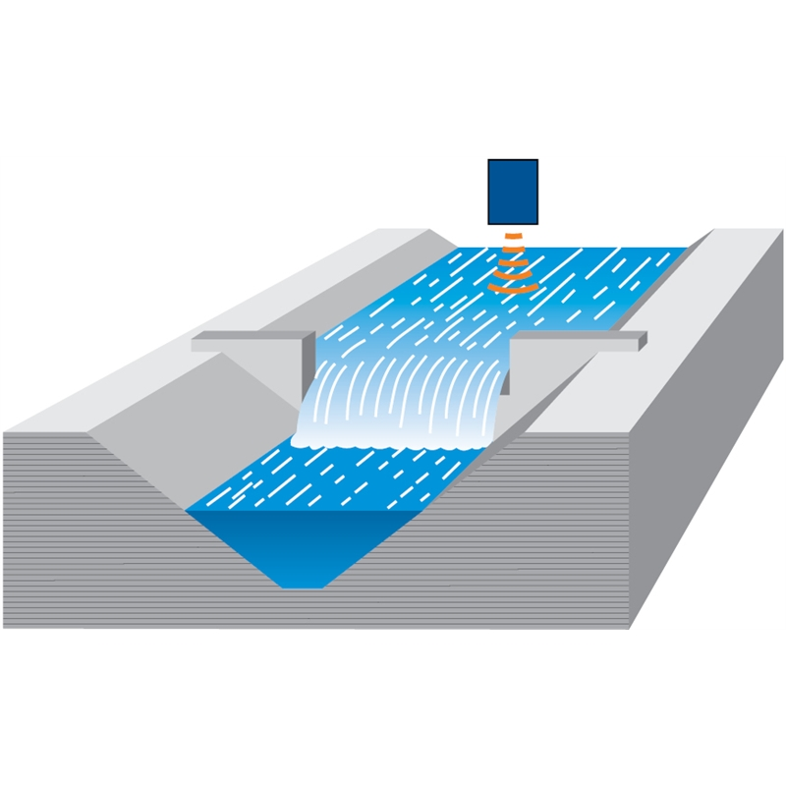
Flow in open channels
Flow in Open Channels Dr. Afsaneh Mojra

Slide 4
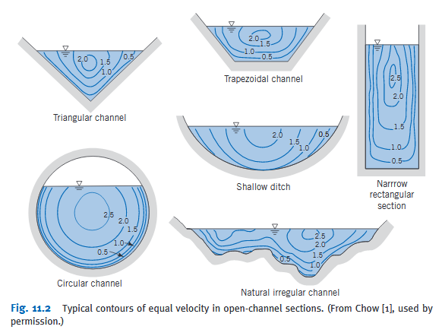
Flow in open channels
Flow in Open Channels Dr. Afsaneh Mojra

Slide 5
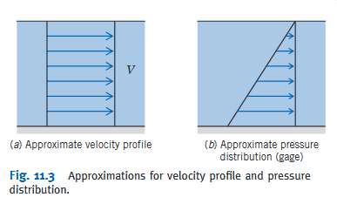
Flow in open channels
Flow in Open Channels Dr. Afsaneh Mojra

Slide 6
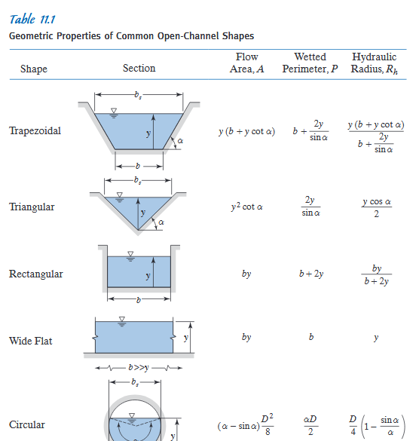
Flow in Open Channels Dr. Afsaneh Mojra

Slide 7
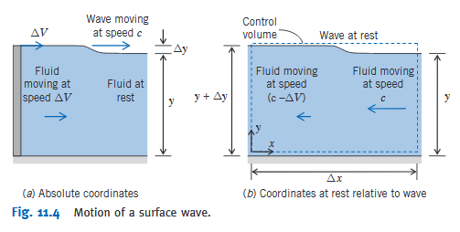
Flow in open channels
Flow in Open Channels Dr. Afsaneh Mojra

Slide 8
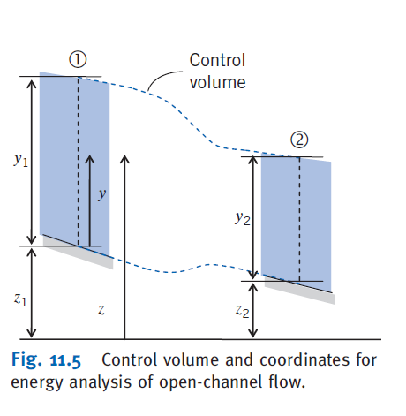
Flow in open channels
Flow in Open Channels Dr. Afsaneh Mojra

Slide 9
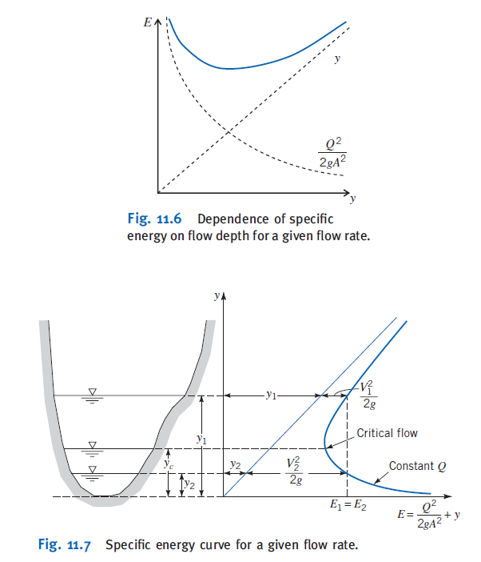

Slide 10
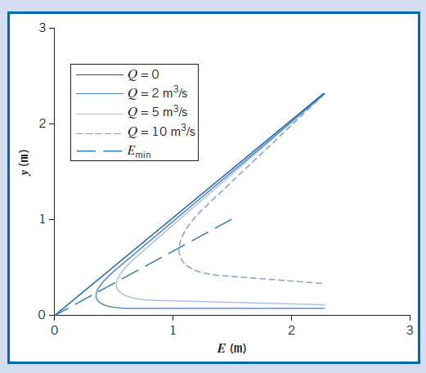
Flow in open channels
Flow in Open Channels Dr. Afsaneh Mojra

Slide 11
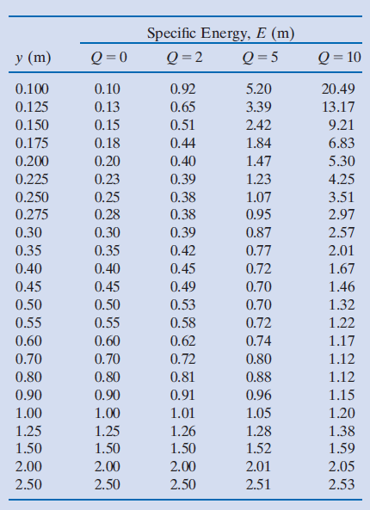
Flow in open channels
Flow in Open Channels Dr. Afsaneh Mojra

Slide 12
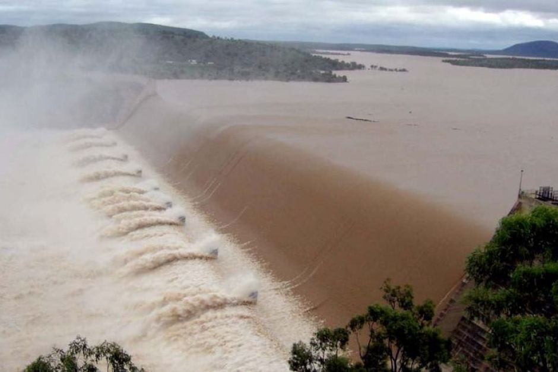
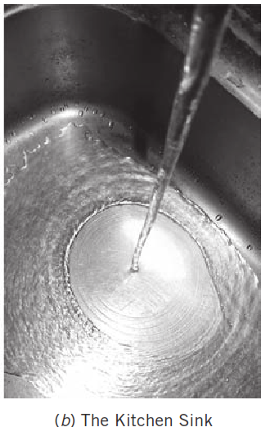
Flow in open channels
Hydraulic jump
Flow in Open Channels Dr. Afsaneh Mojra

Slide 13
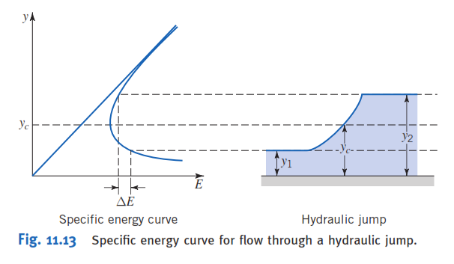
Flow in open channels
Flow in Open Channels Dr. Afsaneh Mojra

Slide 14
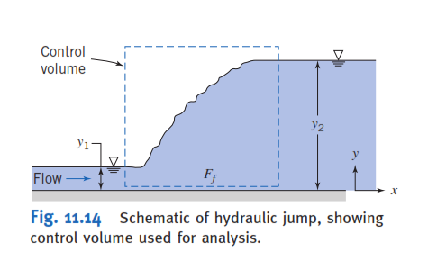
Flow in open channels
Flow in Open Channels Dr. Afsaneh Mojra

Slide 15
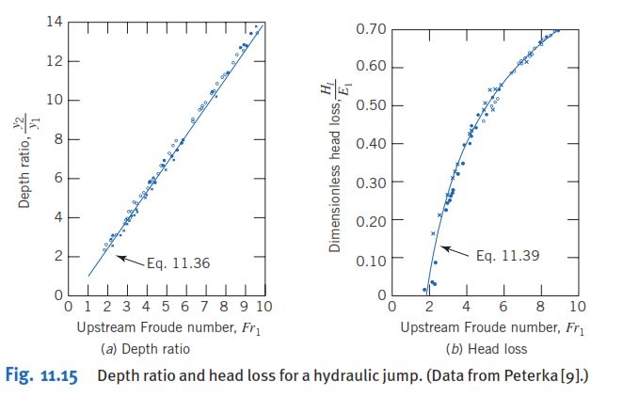
Flow in open channels
Flow in Open Channels Dr. Afsaneh Mojra

Slide 16
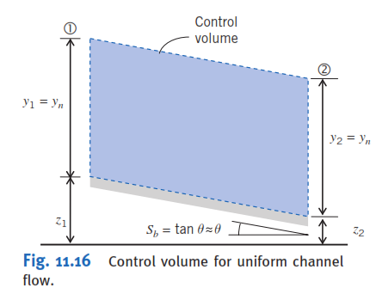
Flow in open channels
Steady Uniform Flow
Flow in Open Channels Dr. Afsaneh Mojra

Slide 17
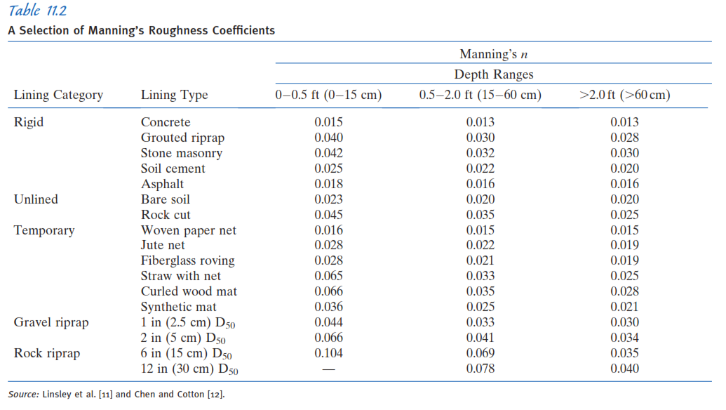
Flow in open channels
Flow in Open Channels Dr. Afsaneh Mojra

Slide 18
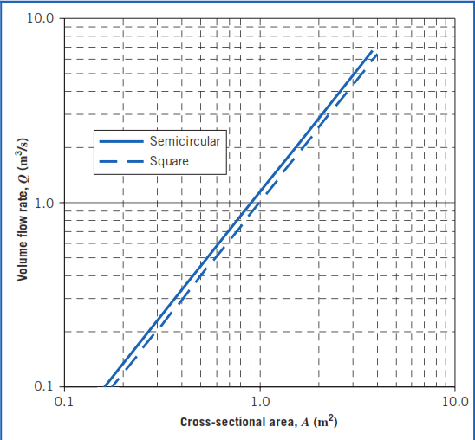
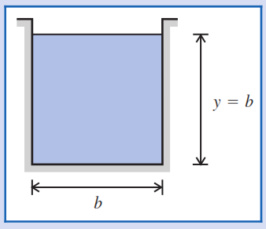
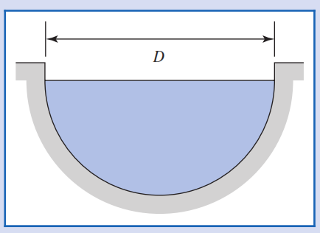
Flow in open channels
Flow in Open Channels Dr. Afsaneh Mojra

Slide 19
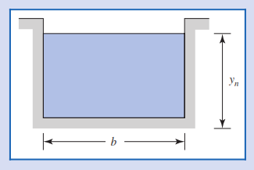
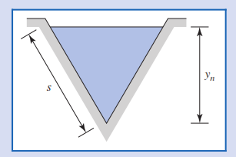
Flow in open channels
Flow in Open Channels Dr. Afsaneh Mojra

Slide 20
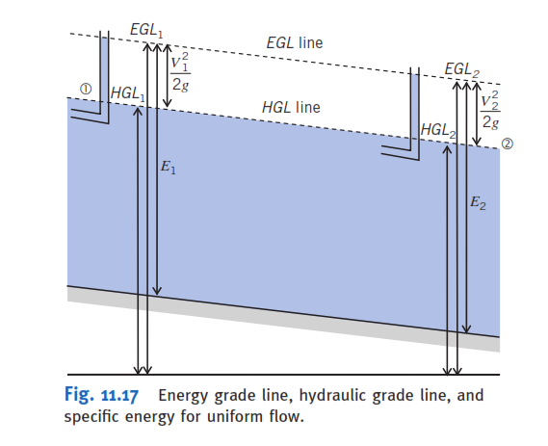
Flow in open channels
Flow in Open Channels Dr. Afsaneh Mojra

Slide 21
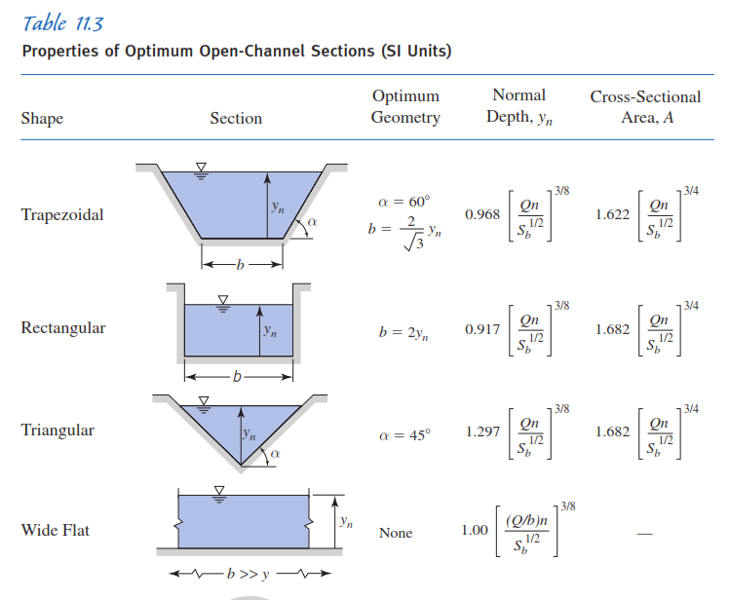
Flow in Open Channels Dr. Afsaneh Mojra

