Slide 1

Nyquist-Rate Digital-to-Analog Converters

Slide 2
DAC Architectures
Notes:
Chiu's Slides

Slide 3
DAC Architectures
Decoder Based
Binary-weighted
Unit-element (thermometer-coded)
Segmented
Notes:
Chiu's Slides

Slide 4
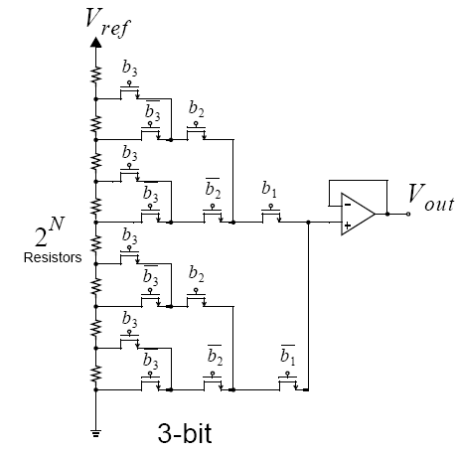
Resistor-String DAC with a Tree-Like Decoder
B1: MSB
B3: LSB
Notes:
Chiu's Slides

Slide 5
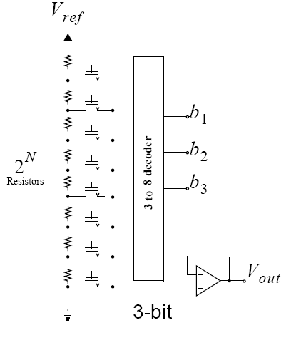
Resistor-String DAC with Digital Decoding
B1: MSB
B3: LSB
Notes:
Chiu's Slides

Slide 6
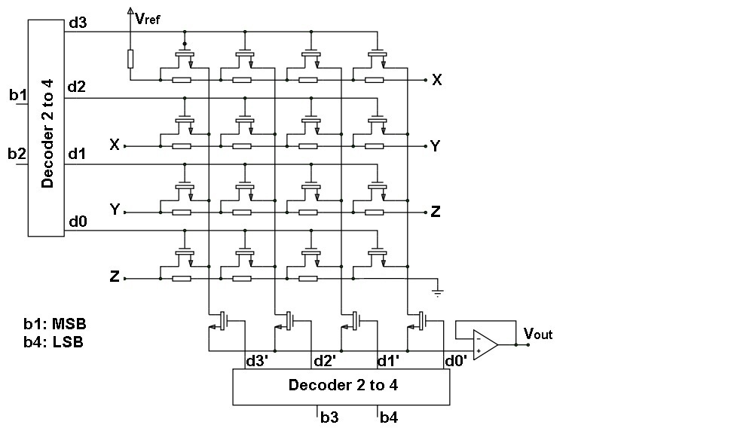
Folded Resistor-String DAC
Notes:
Chiu's Slides

Slide 7
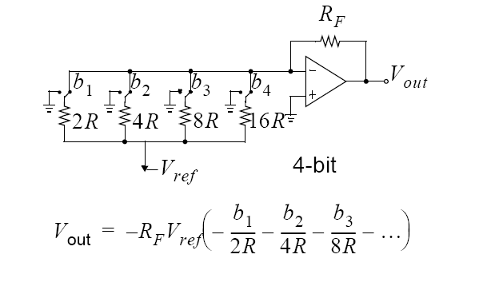
Binary-Weighted Resistor DAC
B1: MSB
B4: LSB
Notes:
Chiu's Slides

Slide 8
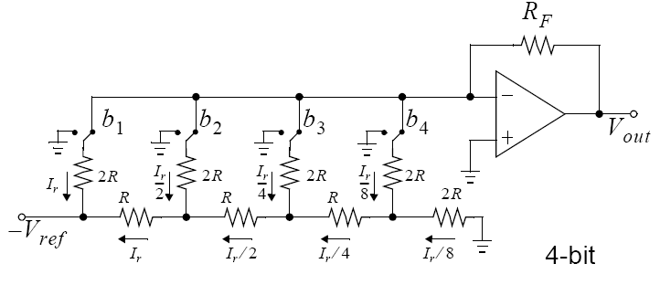
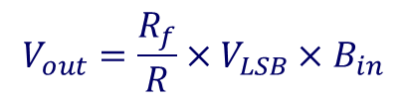
Binary-Weighted R-2R DAC
B1: MSB
B4: LSB
Notes:
Chiu's Slides

Slide 9
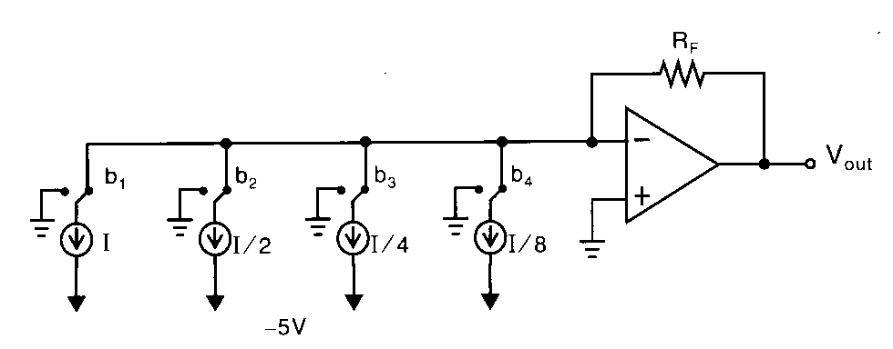
Binary-Weighted Current-Mode DAC
B1: MSB
B4: LSB
Notes:
Chiu's Slides

Slide 10
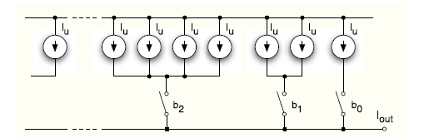

Binary-Weighted Current-Steering DAC
bn-1: MSB
b0: LSB
Notes:
Chiu's Slides

Slide 11
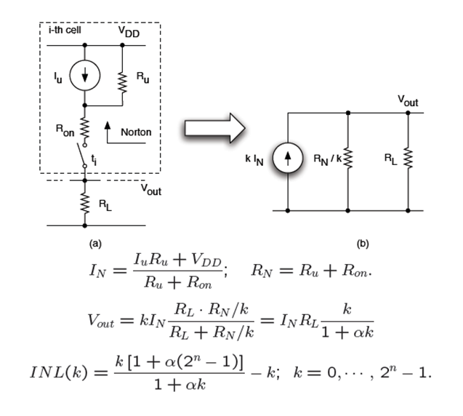

Simplified Model
$$=\frac{R_{L}}{R_{N}}$$
Notes:
Chiu's Slides

Slide 12


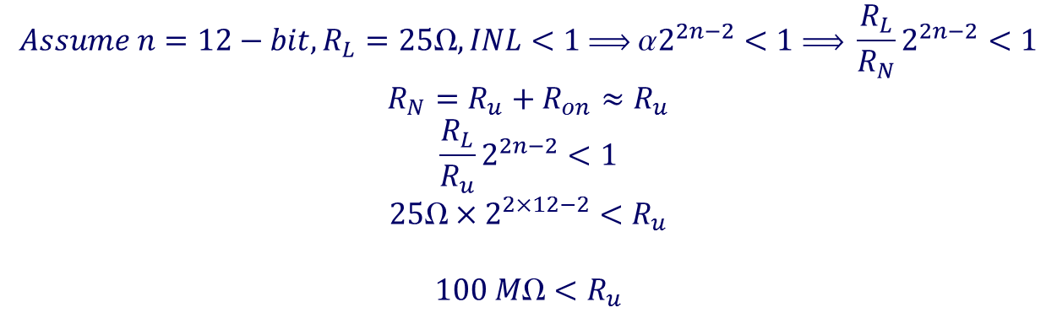
Simplified Model
$$Assume n=12−bit, R_{L}=25Ω, INL<1  α2^{2n−2}<1  \frac{R_{L}}{R_{N}}2^{2n−2}<1$$
$$R_{N}=R_{u}+R_{on}≈R_{u}$$
$$\frac{R_{L}}{R_{u}}2^{2n−2}<1$$
$$25×2^{2×12−2}<R_{u}$$
$$100 M<R_{u}$$
Notes:
Chiu's Slides

Slide 13


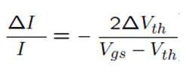



Random Mismatch in Current Sources
Assuming constant β, we have:
Assuming constant Vth, we have:
Assuming Vth and β are independent and have Gaussian pdf, we have:
Variances of Vth and β depend on W×L and technology as follows:
Notes:
Chiu's Slides

Slide 14
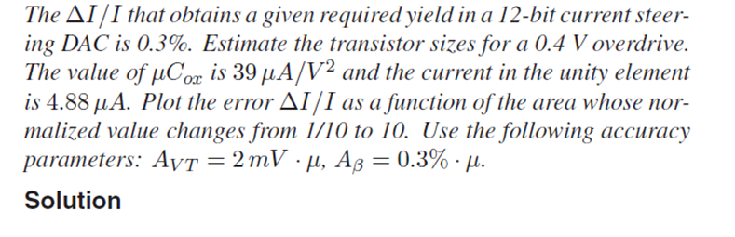
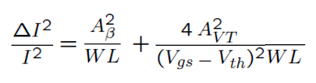
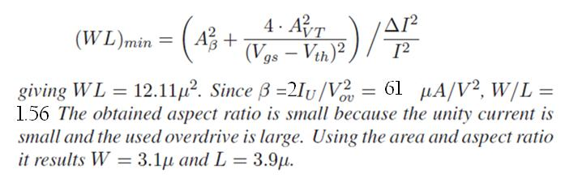
Example
Notes:
Chiu's Slides

Slide 15
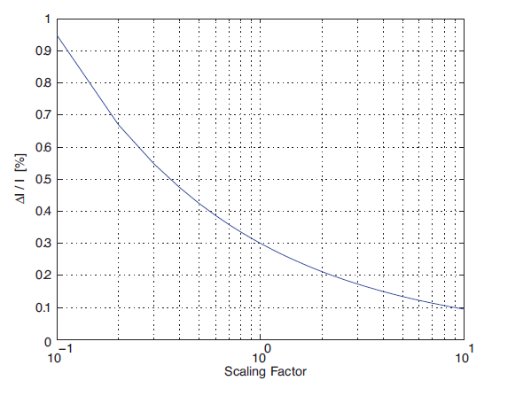
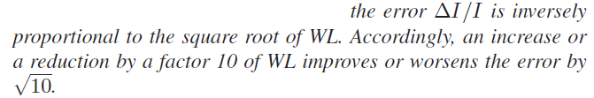
Con’td
Notes:
Chiu's Slides

Slide 16
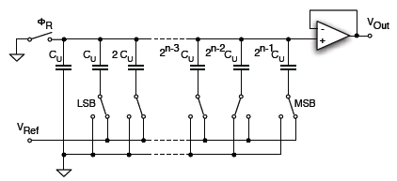
Binary-Weighted Charge-Redistribution DAC
B0: LSB
Bn-1: MSB
Notes:
Chiu's Slides

Slide 17
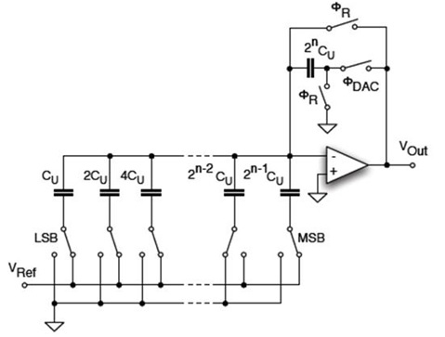
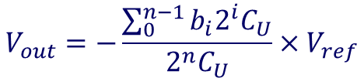
Binary-Weighted Charge-Redistribution DAC
B0: LSB
Bn-1: MSB
Notes:
Chiu's Slides

Slide 18
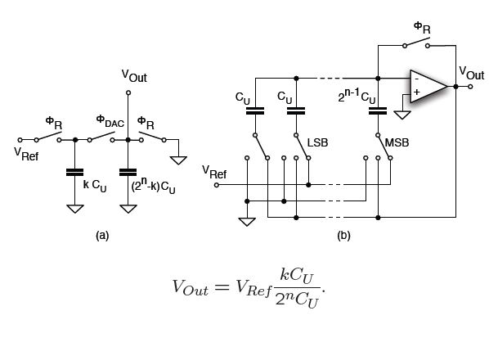
Binary-Weighted Charge-Redistribution DAC
B0: LSB
Bn-1: MSB
Notes:
Chiu's Slides

Slide 19
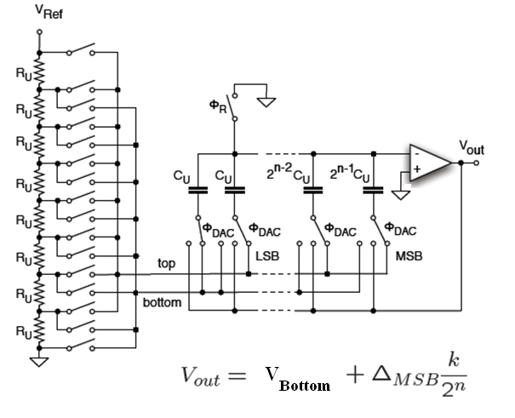

Binary-Weighted Hybrid Capacitive-Resistive DAC
B0: LSB
Bn-1: MSB
Overall Resolution: n+3
Notes:
Chiu's Slides

Slide 20
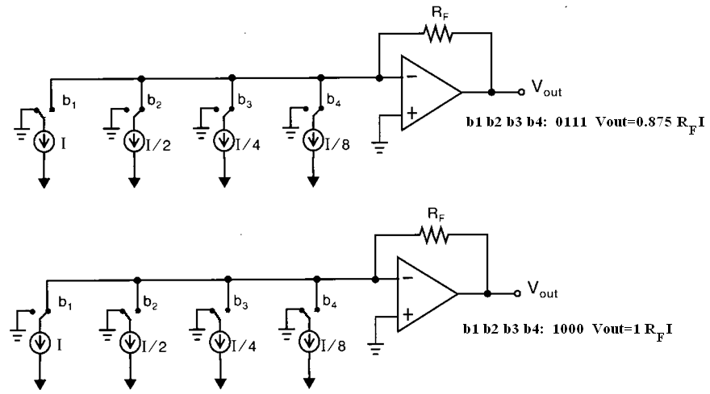
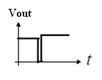
Glitch Problem of the Binary-Weighted DAC
Due to timing error , we may have:
Notes:
Chiu's Slides

Slide 21
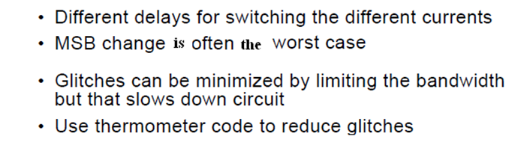
Glitch Problem (cont’d)
Notes:
Chiu's Slides

Slide 22
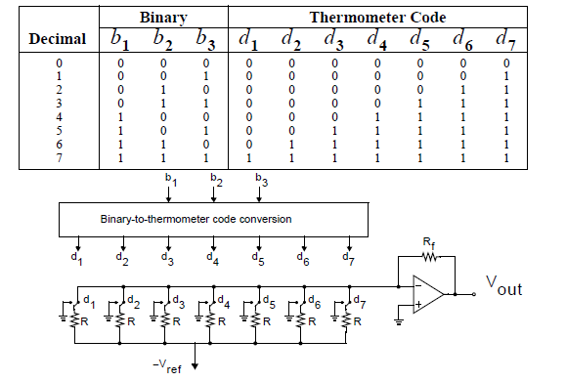
Unit Element (Thermometer code) DAC
Notes:
Chiu's Slides

Slide 23
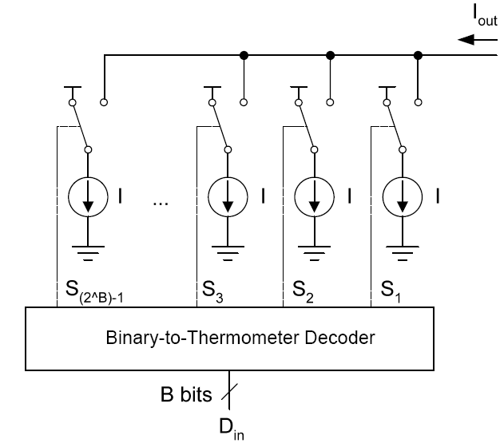
Unit Element DAC (cont’d)
Notes:
Chiu's Slides

Slide 24
Segmented DAC
MSB DAC: M-bit Unit Element DAC
LSB DAC: L-bit Binary Weighted DAC
Resolution: N = M + L
2^{M}+L switching elements
Small glitches
Notes:
Chiu's Slides

Slide 25
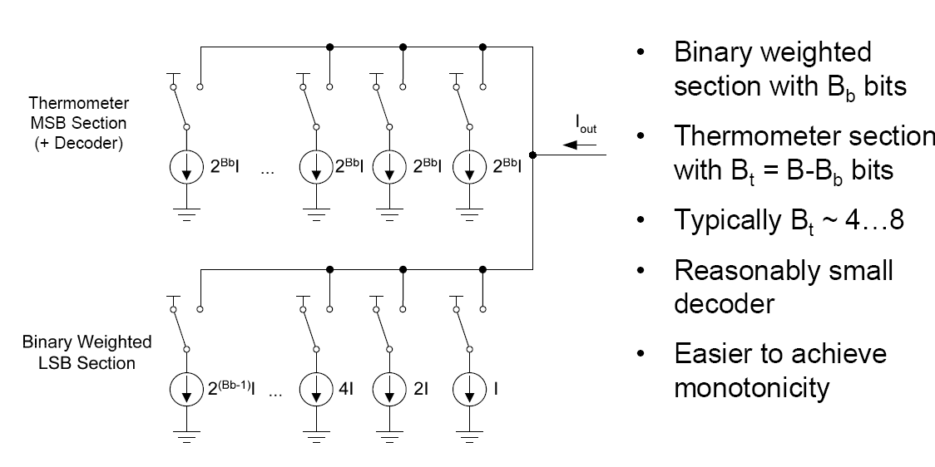
Segmented DAC
Notes:
Chiu's Slides

Slide 26
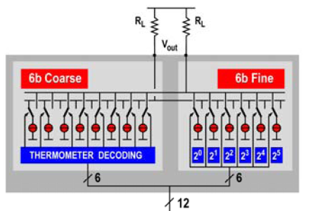
Segmented DAC
Current Steering DAC
Notes:
Chiu's Slides

Slide 27
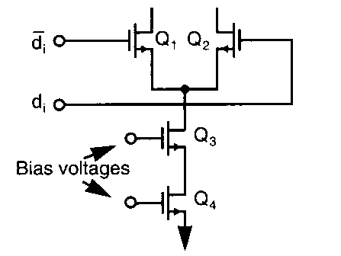
Current Cell
Notes:
Chiu's Slides

Slide 28
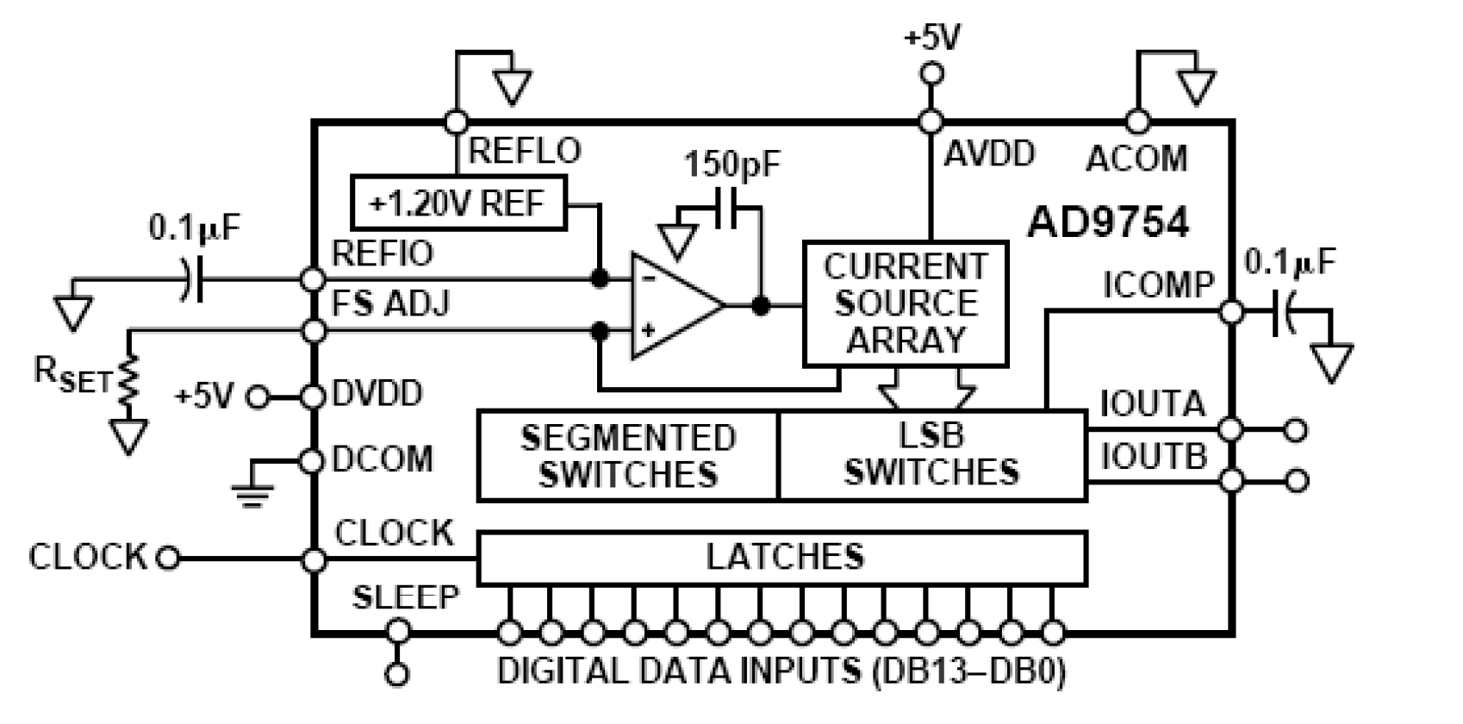
Commercial Example (AD9754)
Notes:
Chiu's Slides

Slide 29
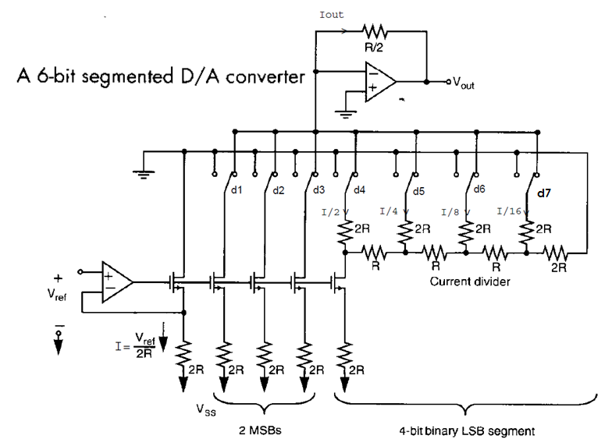
Segmented DAC
Notes:
Chiu's Slides

