Slide 1
Altium Tutorial
Alireza A. Bazargani
May 2015

Slide 2
Project Definition

Slide 3
Create a new project & save it

Slide 4
Adding Schematic File

Slide 5
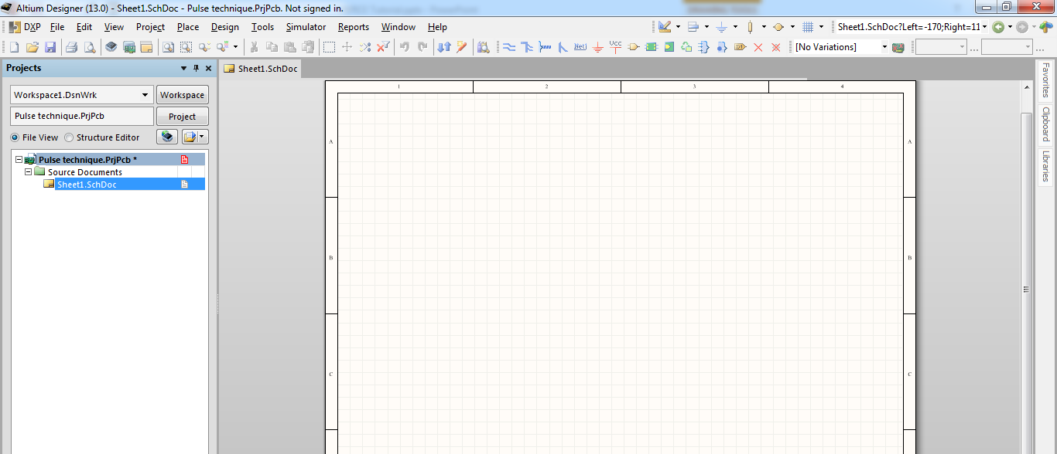
Adding Schematic File

Slide 6
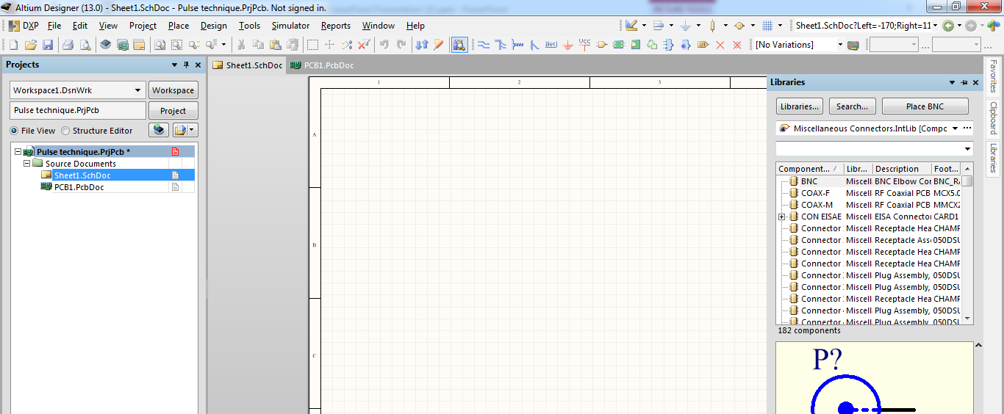
Importing Components

Slide 7
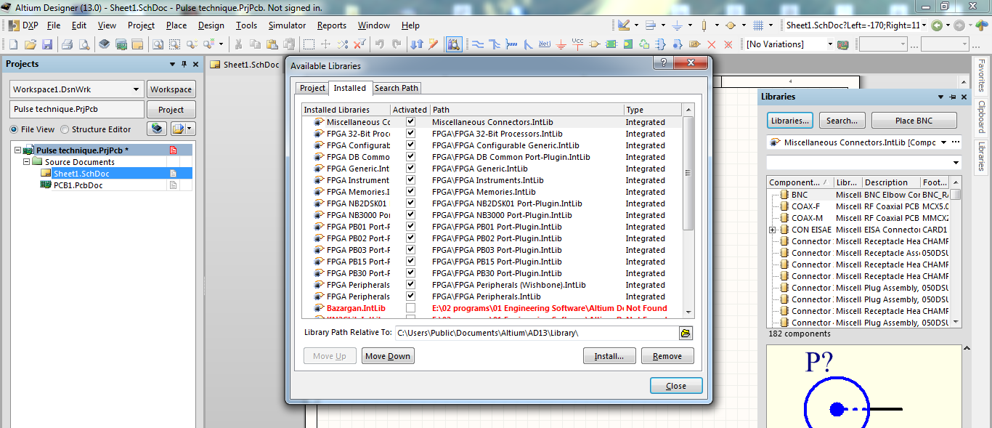
Installing New Library

Slide 8
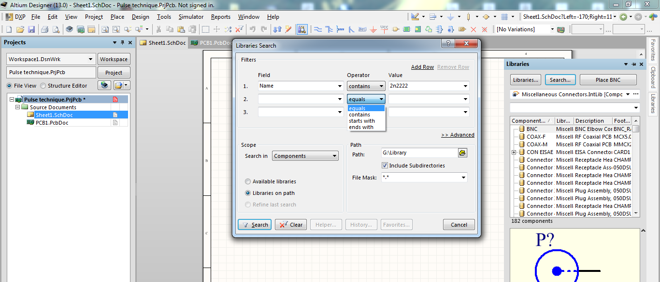
Searching a Component

Slide 9
Placing a Component

Slide 10
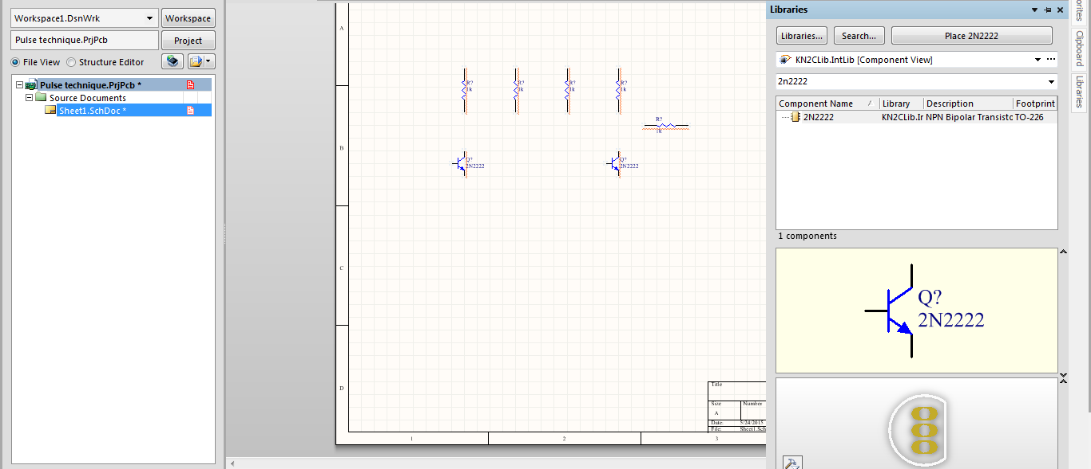
Placing a Component

Slide 11
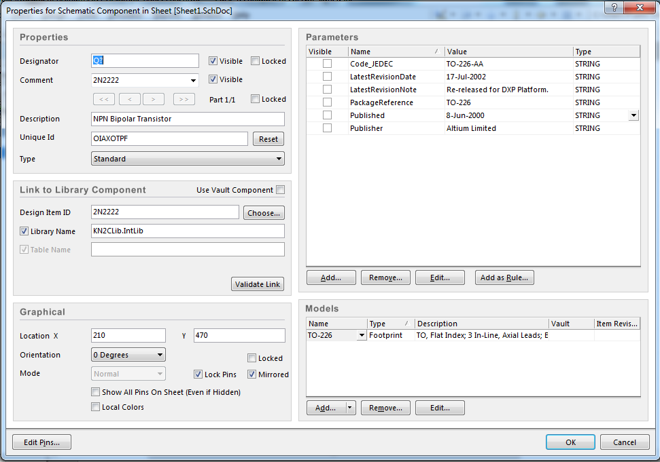
Component Properties

Slide 12
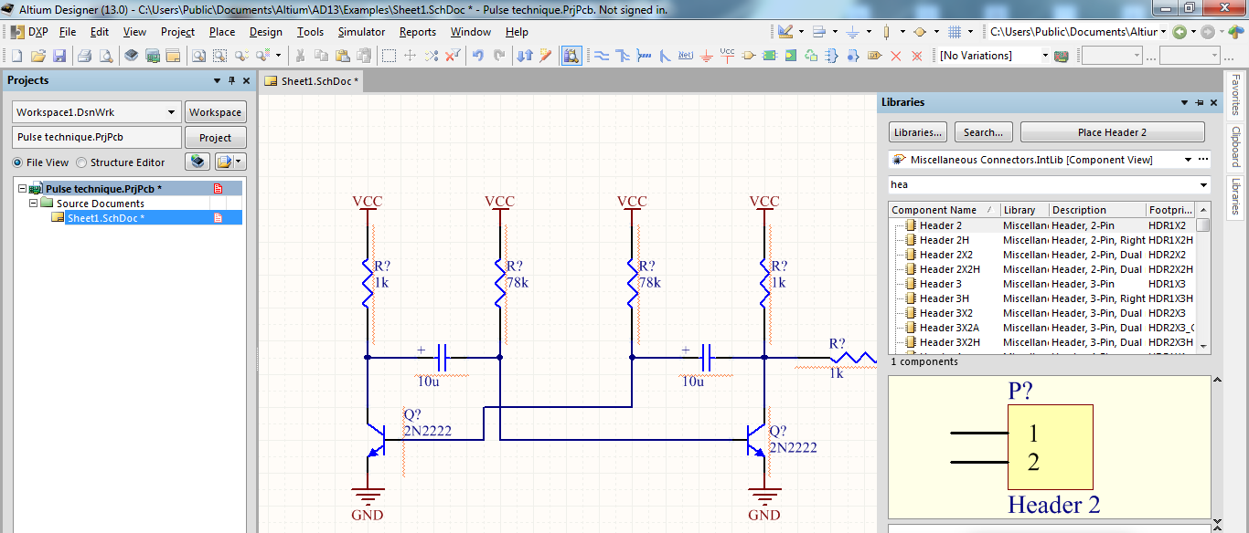
Routing

Slide 13
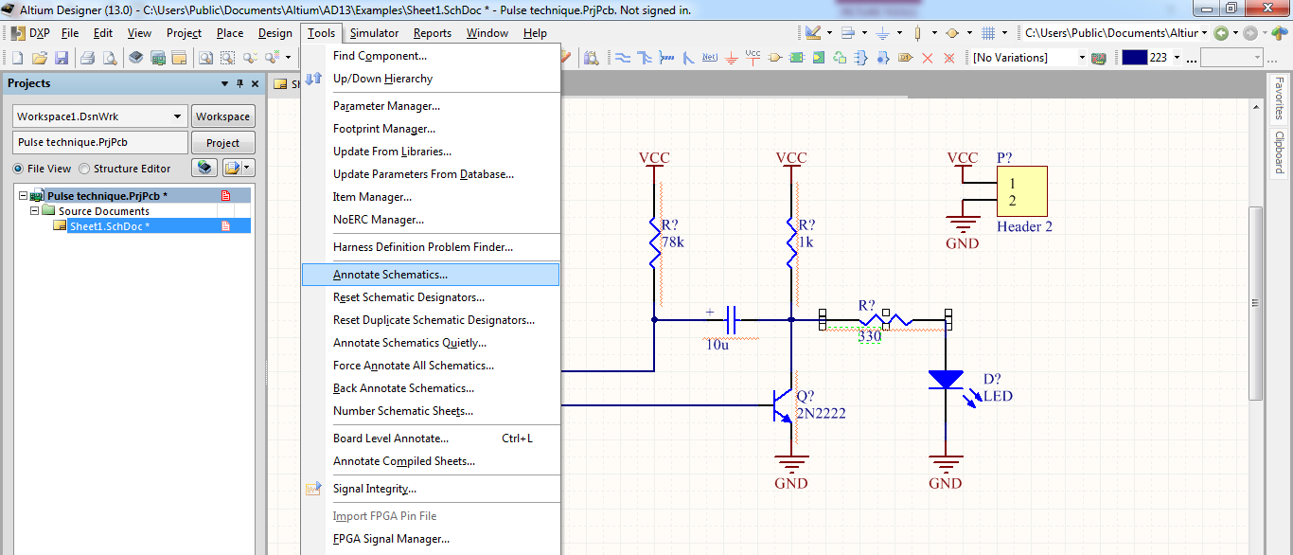
Annotation

Slide 14
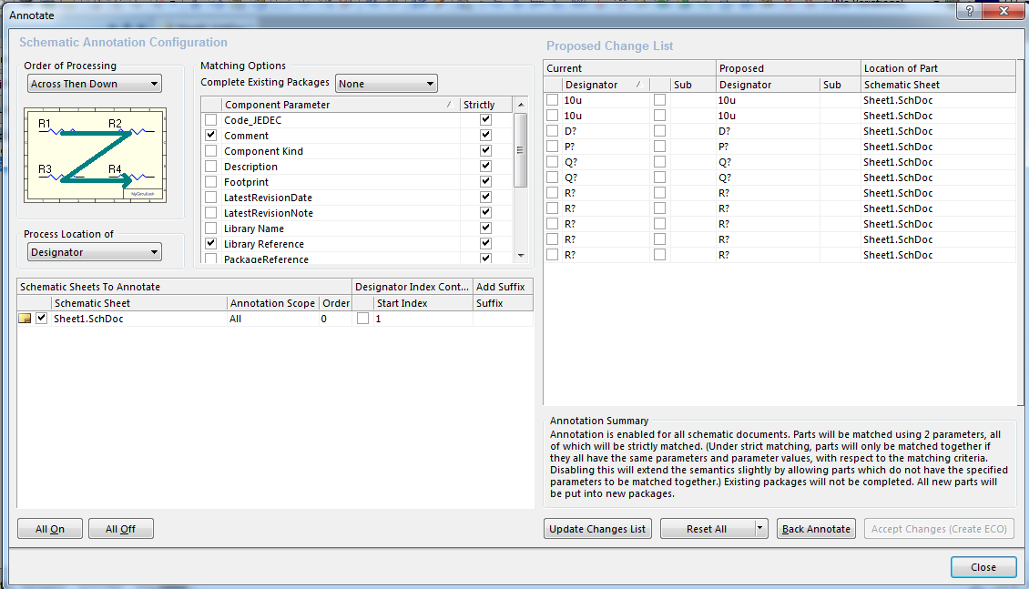
Annotation

Slide 15
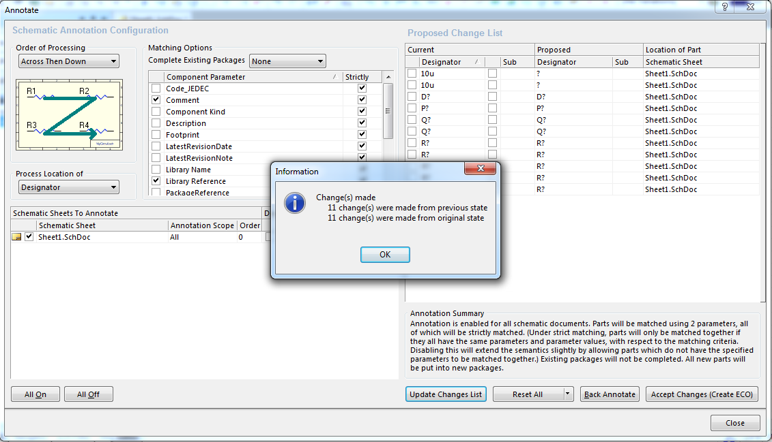
Annotation

Slide 16
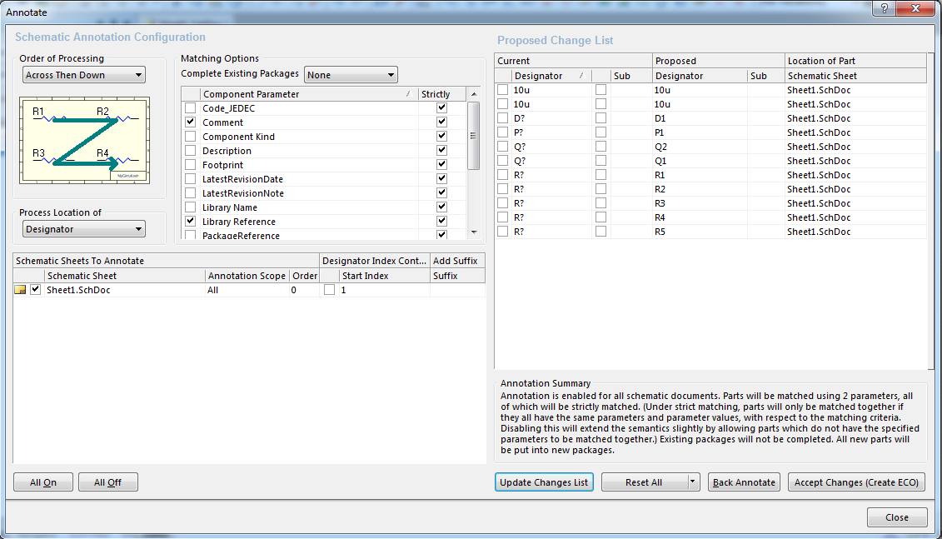
Annotation

Slide 17
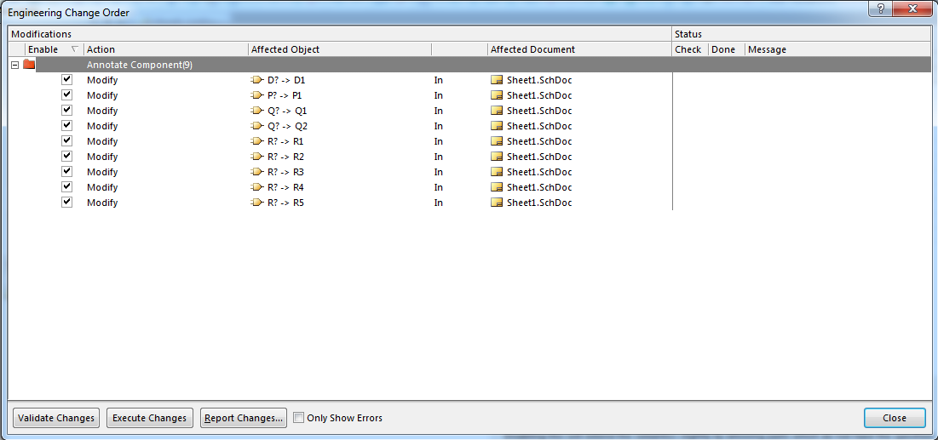
Annotation

Slide 18
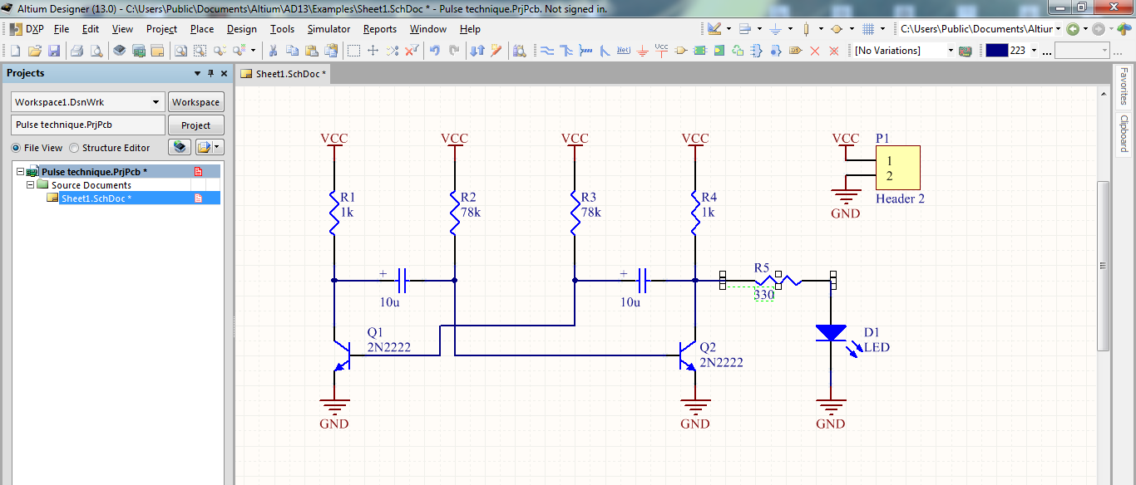
Save

Slide 19
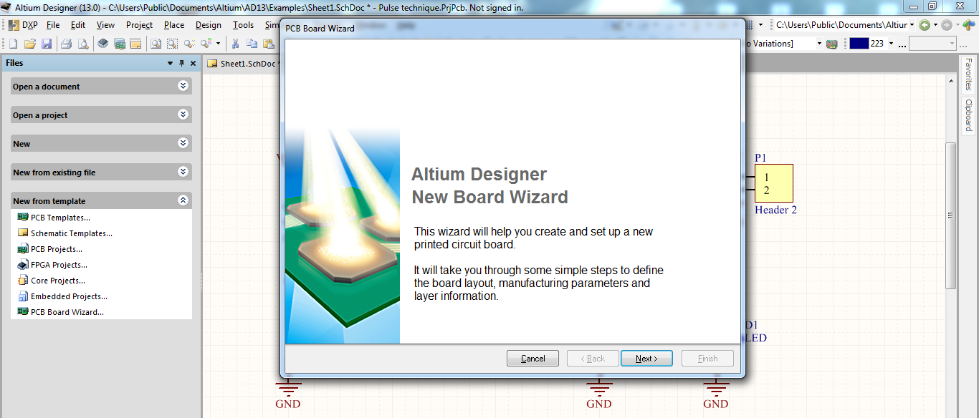
Creating PCB File

Slide 20
Creating PCB File

Slide 21
Creating PCB File

Slide 22
Creating PCB File

Slide 23
Creating PCB File

Slide 24
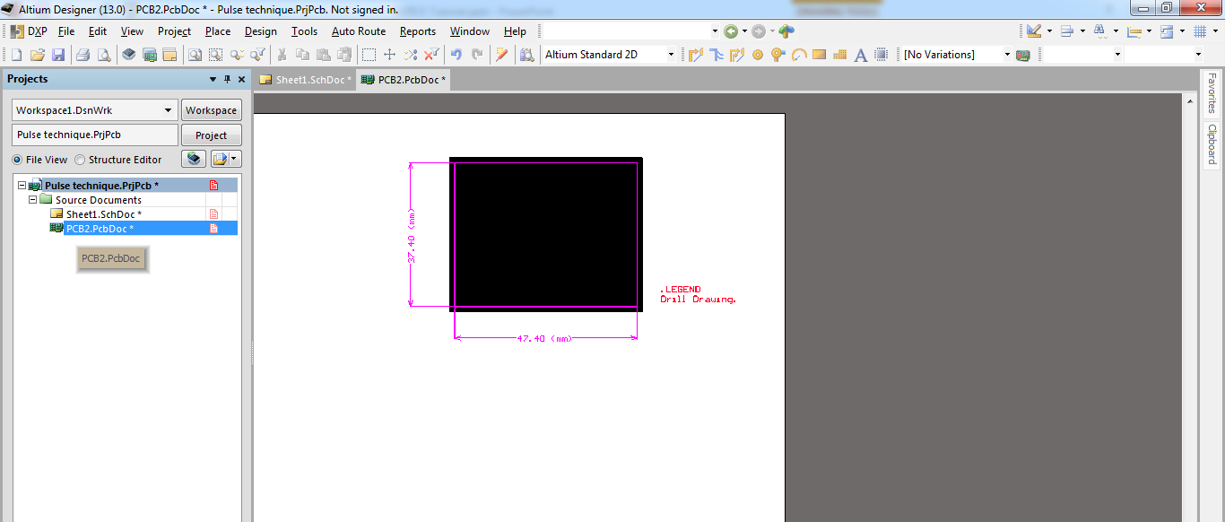
Creating PCB File

Slide 25
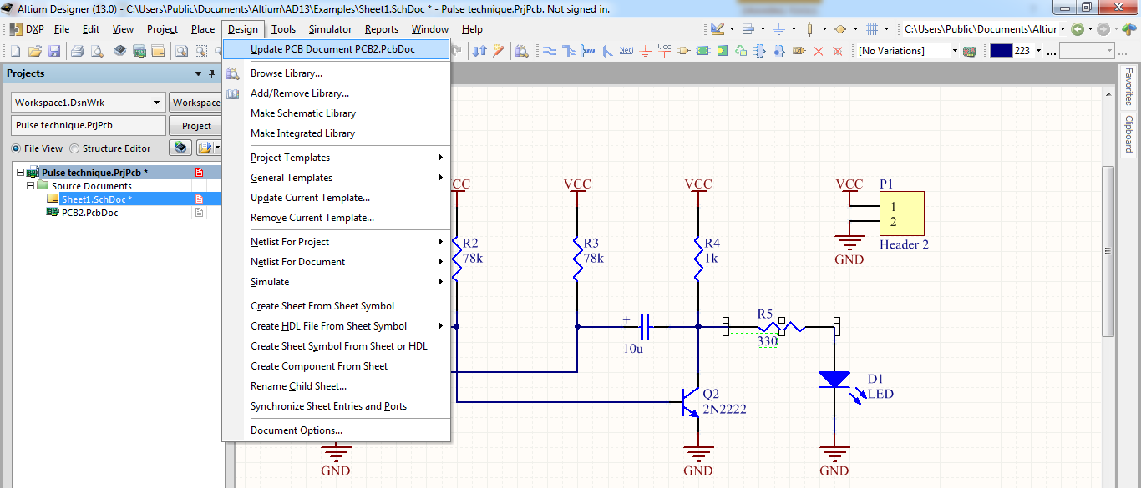
PCB

Slide 26
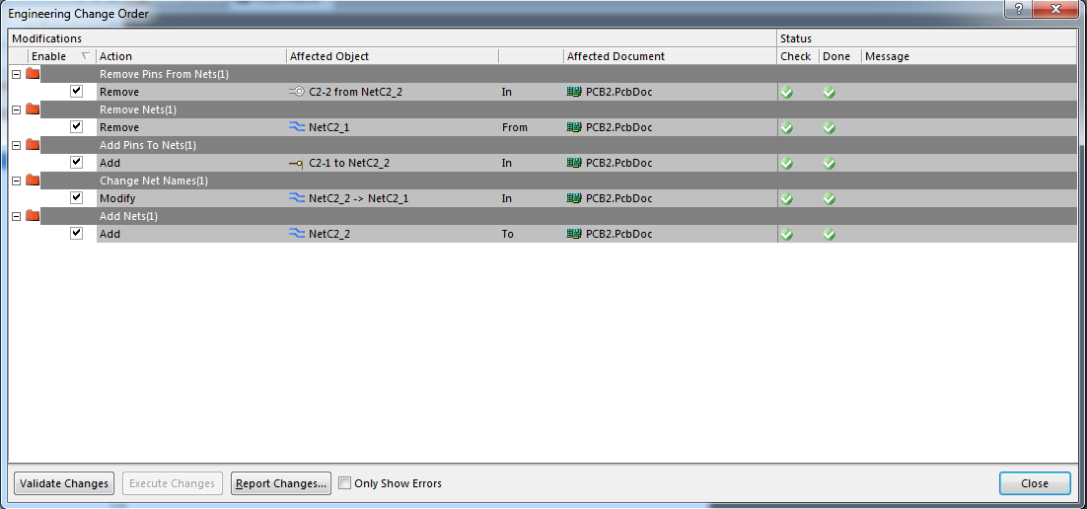
PCB

Slide 27
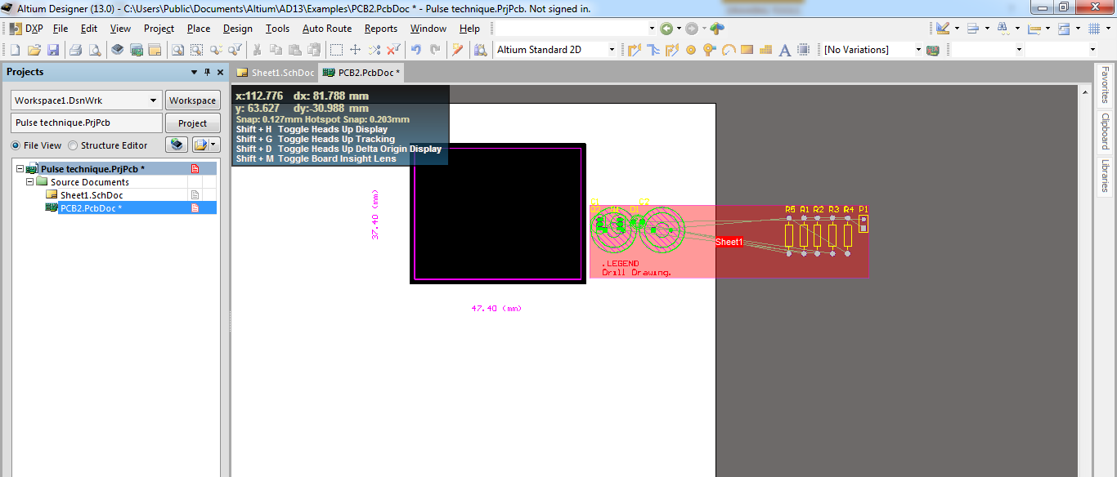
PCB

Slide 28
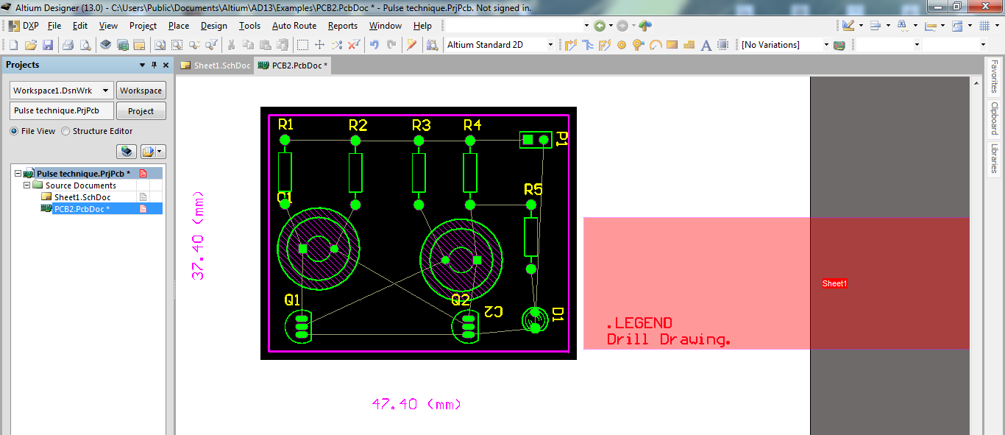
Component Arrangement

Slide 29
Design Rules

Slide 30
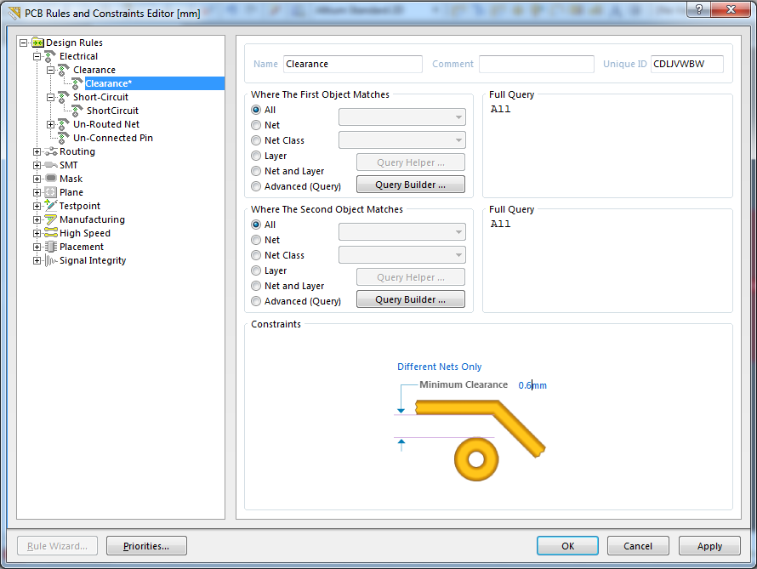
Design Rules

Slide 31
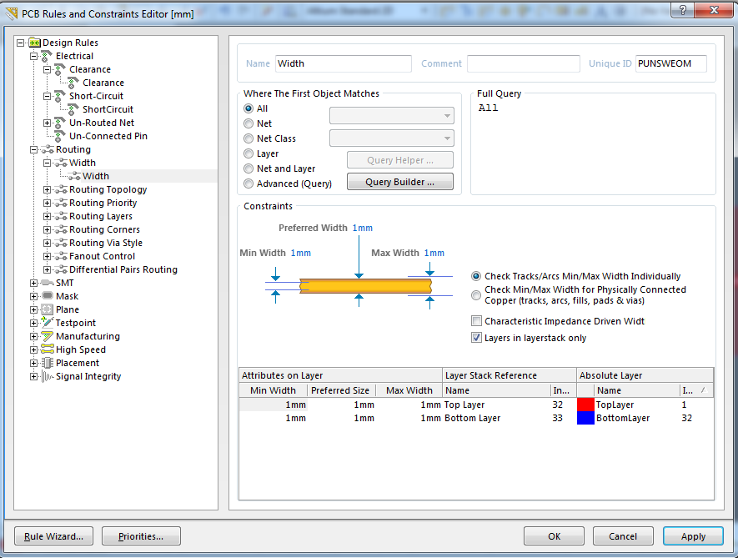
Design Rules

Slide 32
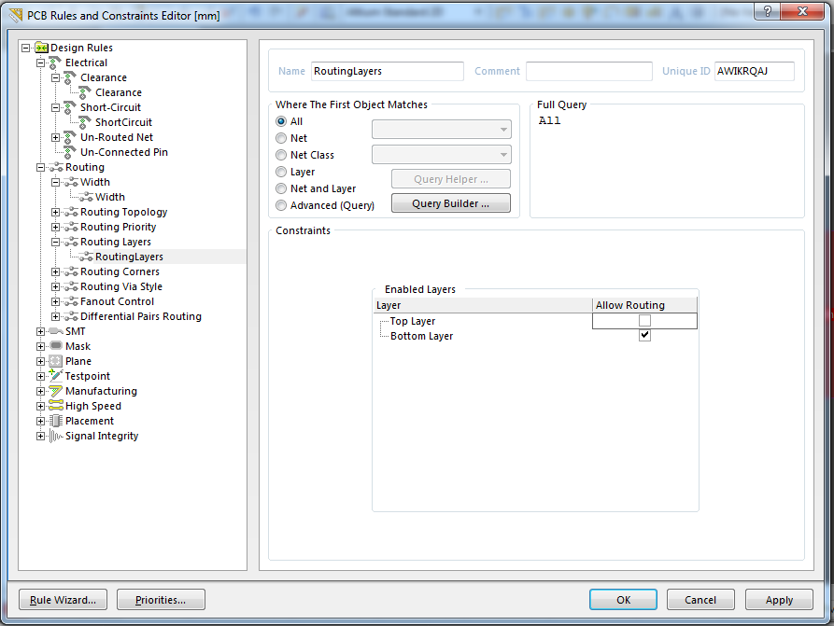
Design Rules

Slide 33
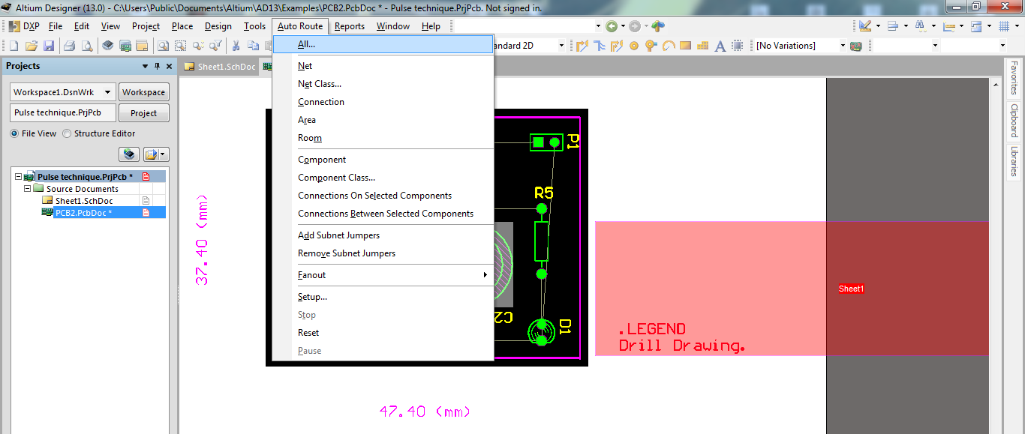
Auto Rout

Slide 34
Routing (BL)

Slide 35
Line Width

Slide 36
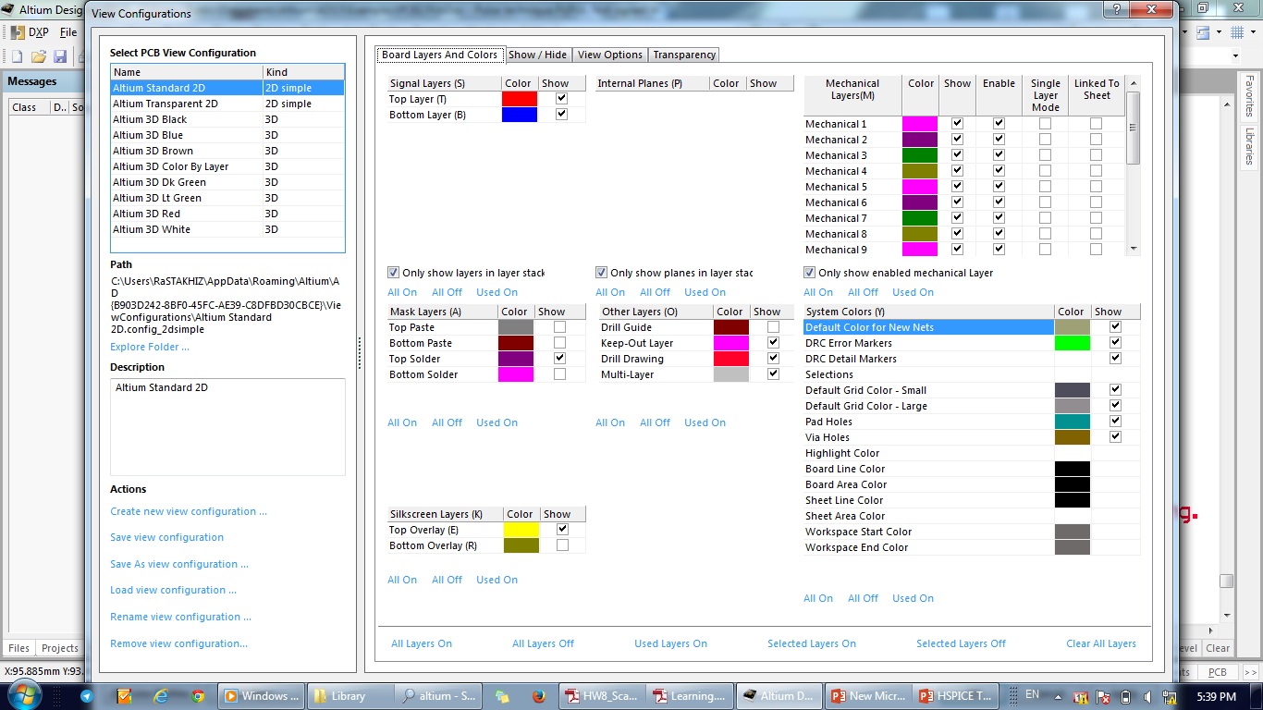

Slide 37
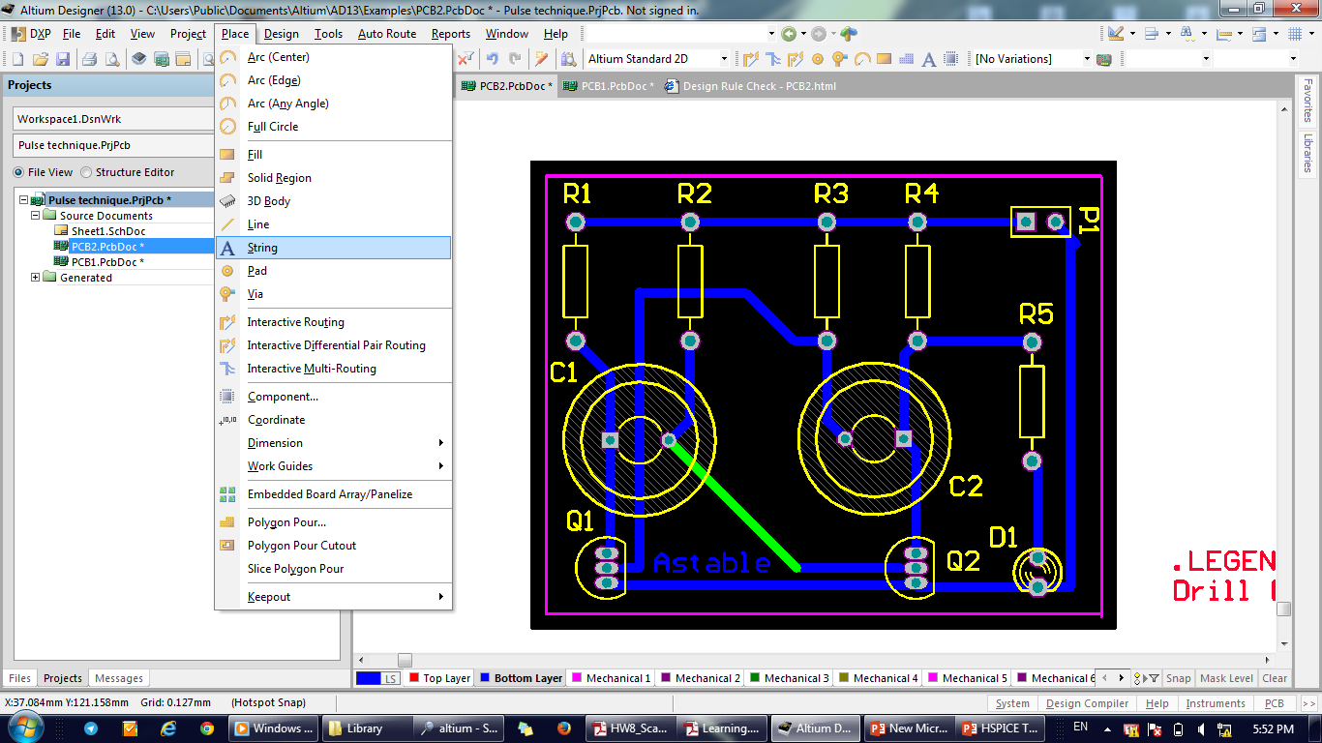
Adding Text

Slide 38
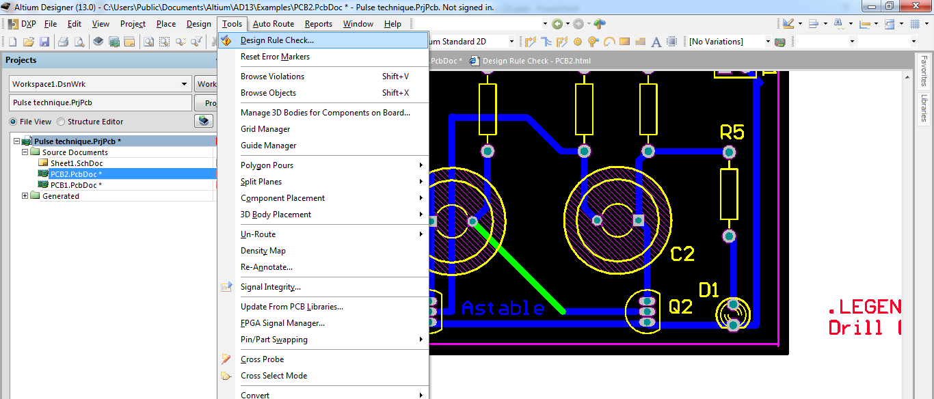
Checking Design Rules

Slide 39
Checking Design Rules

Slide 40
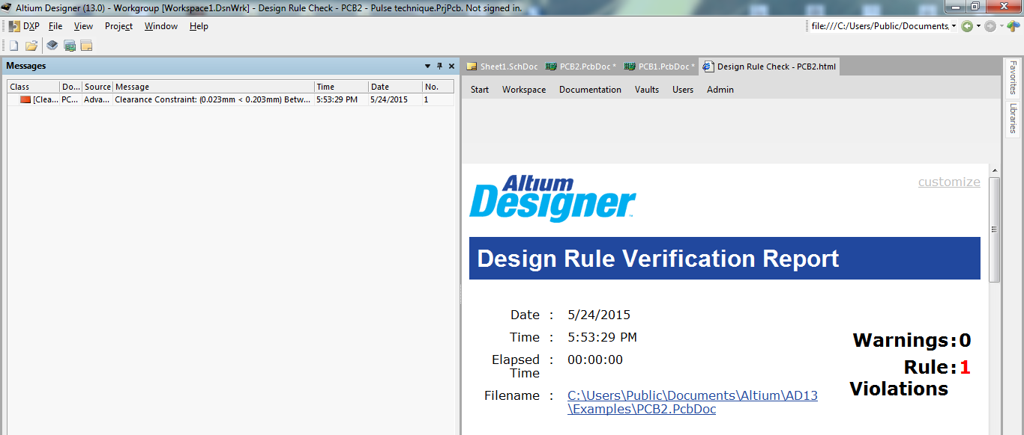
Checking Design Rules

